Slide 1
Topic 1 Notices
CAB202 – Microprocessors and Digital Systems
Unit Coordinator: Luis Mejias Alvarez
Lecturer: Lawrence Buckingham

Slide 2

Acknowledgement of Traditional Owners
In keeping with the spirit of Reconciliation, we acknowledge the Traditional Owners of the lands where QUT now stands, and recognise that these have always been places of teaching and learning.
We wish to pay respect to their Elders - past, present and emerging - and acknowledge the important role Aboriginal and Torres Strait Islander people continue to play within the QUT community.

Slide 3
Conduct
At QUT, we strive to create an environment of respect – where everyone is welcome, comfortable participating, and free from harassment
This unit is governed by our code of conduct, and I want to thank you for doing your part towards building an inclusive community.
If you feel uncomfortable, or if there are any other issues that need addressing, please come and see me, or any other member of the teaching team – we're happy to assist.

Slide 4


Need help with maths, science or IT concepts and skills?
Visit HiQ’s new learning zones
(GP library, V block, level 2 and KG library, R block, level 3) for:
drop-in support sessions with STIMulate Peer Learning Facilitators
online worksheets, texts and other resources
group support sessions with specialist MSIT Educators
All QUT students welcome!
For times and more information,
check the student website or our Blackboard site.
https://www.student.qut.edu.au/learning-and-assessment/workshops-and-academic-help/academic-help
www.tinyurl.com/stimulate-bb

Slide 5
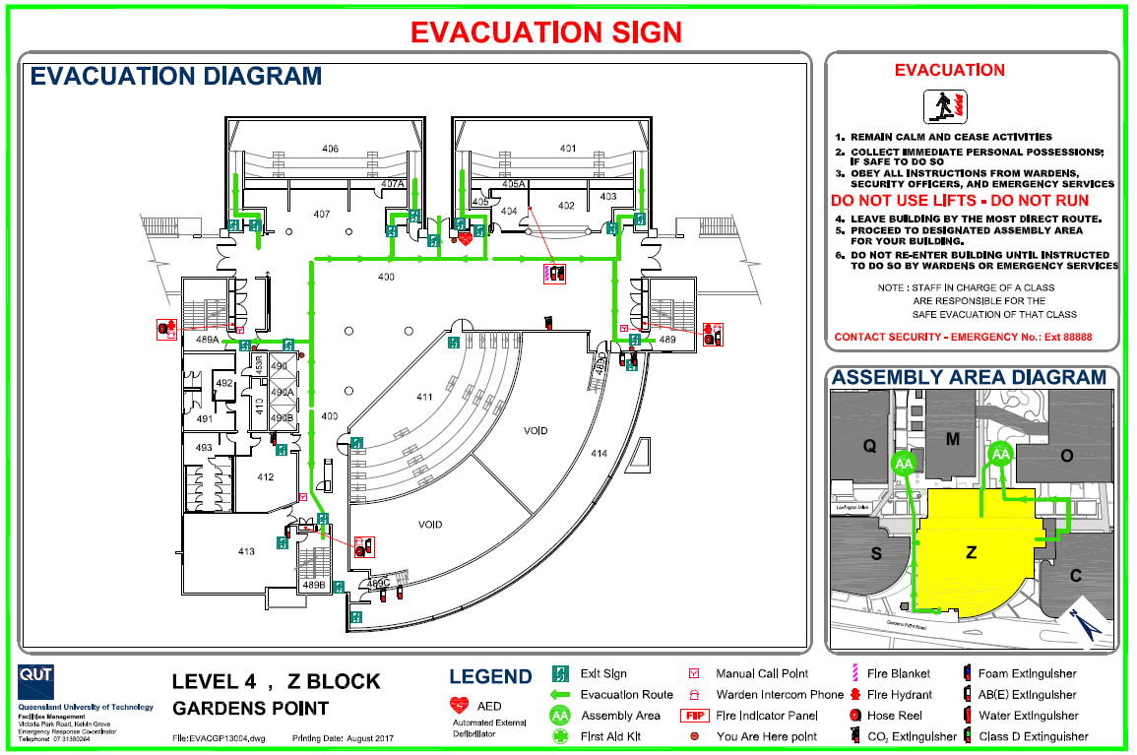

Slide 6
about:today
Housekeeping
Organisation
Assessment
Where to go for help
Writing our first C programs
Character oriented I/O
Review structured programming
Sequence; Selection; iteration.

Slide 7
about:cab202
Delivery mode:
Lecture – 2hr, demonstration style
Tutorial – 2hr, guidance and feedback from tutor
Assessment:
Continuous: Portfolio items; 30%; submit and graded via AMS.
Week 7, Monday: Assignment 1; 30%; submit via AMS and Blackboard; graded by tutors.
Week 13, Monday: Assignment 2; 40%; submit via AMS and Blackboard; graded by tutors;
DEMO A2 IN TUTORIAL. WEEK 13. NO SHOW, NO MARK.

Slide 8
Workload
http://www.mopp.qut.edu.au/C/C_03_01.jsp#C_03_01.05.mdoc
“Using this guide, and recognising that actual time will vary for each student, a 12 credit unit is designed to take approximately 150 hours.”
Expect to invest about an hour per percentage point into each assessment item.
CAB202 is challenging but rewarding.
You need to enjoy programming, and exhibit responsibility, resourcefulness, initiative, and perseverance.
Prepare to teach yourself; don’t wait for us to tell you the “answer”.

Slide 9
AMS == Automated Marking System
A web-based unit testing framework.
Small, well defined specifications of programs that you will implement.
For given input, every correct implementation will produce the expected output. For the same input, incorrect implementations will produce actual output that is different from the expected output.
AMS runs my code to produce expected output. AMS runs your code on the same input data to produce actual output.
If the actual output does not match the expected output, then your program contains at least one error. AMS tells you about this and you can try again.

Slide 10
Why AMS?
AMS is specific and objective.
AMS helps you learn to program.
AMS gives you instant feedback.
AMS gives you plenty of attempts.
AMS lets you work at your own pace.
AMS helps you keep up with the workload.
First AMS exercises – 4% – open now; due midnight Monday of Week 2.

Slide 11
Slack Channel
Apart from tutorials, the Unit Slack channel is intended to be the primary point of interaction with other students, and with tutors outside class.
It is part of our shared digital workspace, so it must be treated as such:
Keep it safe, pleasant, respectful, and relevant.
Unhelpful, abusive, distracting or attention-seeking behaviour is not acceptable.
Use your QUT email and real name to sign up
The link to join Slack is available in Class Notices on BB.

Slide 12
References
Steve Oualline, Practical C Programming, 3rd Ed.
eBook: http://QUT.eblib.com.au/patron/FullRecord.aspx?p=741263
Byron Gottfried, Schaum's Outline of Programming With C, 2nd Ed.
Library has 4 copies.
eBook available for purchase from publisher and range of on-line vendors ~ USD20.00.
Deitel & Deitel, C: How To Program, 5th Ed.
Library has 3 copies http://libcat.library.qut.edu.au/record=b2129545~S8

Slide 13
Useful links
For everyday use:
C Standard Library Reference:
https://en.wikipedia.org/wiki/C_standard_library
http://www.cplusplus.com/
GDB Cheat Sheet:
http://www.yolinux.com/TUTORIALS/GDB-Commands.html
More detailed references:
GCC Reference:
https://gcc.gnu.org/onlinedocs/
ISO C Standard
http://www.open-std.org/JTC1/SC22/WG14/www/docs/n1570.pdf

Slide 14
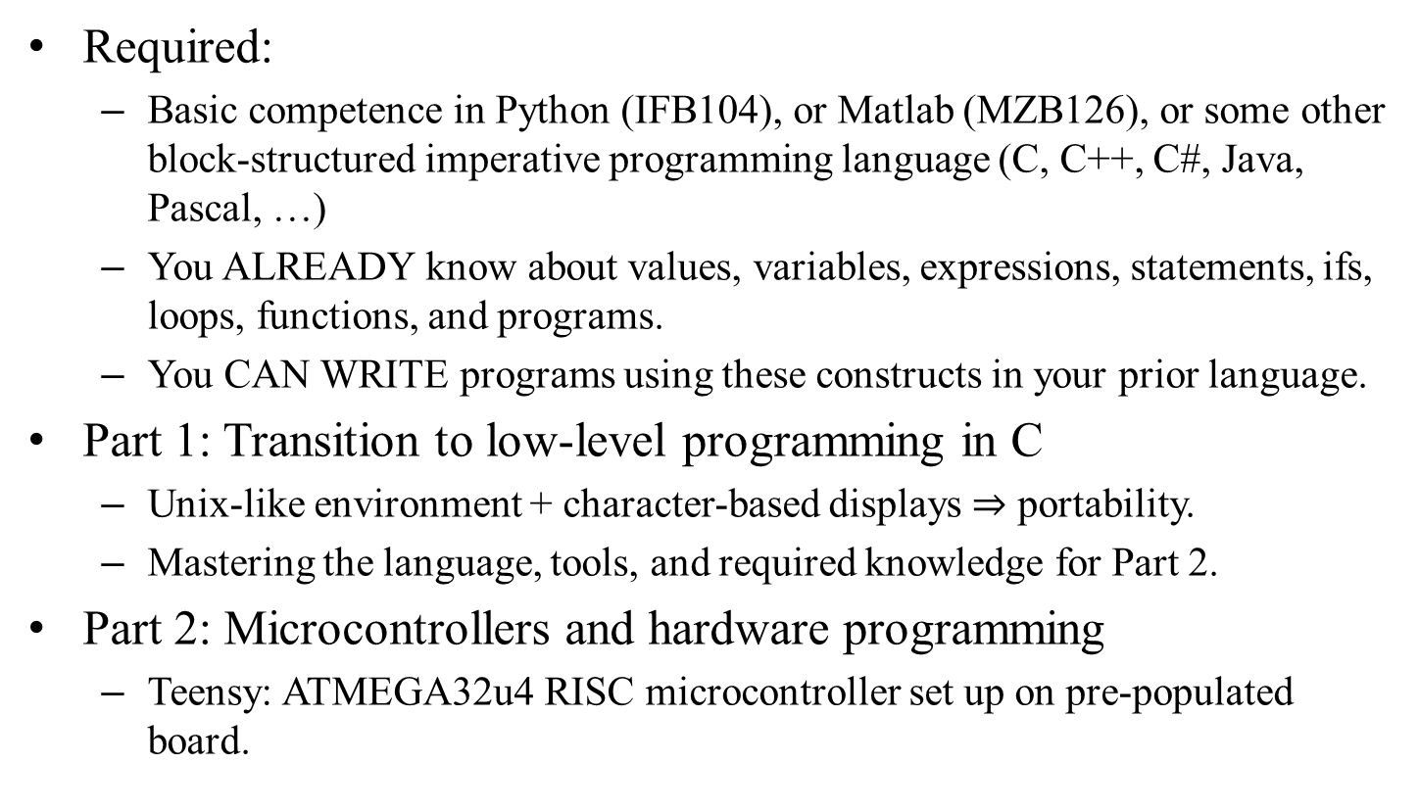
Unit overview
Required:
Basic competence in Python (IFB104), or Matlab (MZB126), or some other block-structured imperative programming language (C, C++, C#, Java, Pascal, …)
You ALREADY know about values, variables, expressions, statements, ifs, loops, functions, and programs.
You CAN WRITE programs using these constructs in your prior language.
Part 1: Transition to low-level programming in C
Unix-like environment + character-based displays $⇒$ portability.
Mastering the language, tools, and required knowledge for Part 2.
Part 2: Microcontrollers and hardware programming
Teensy: ATMEGA32u4 RISC microcontroller set up on pre-populated board.

Slide 15
Microprocessors and Digital Systems
Microprocessors and microcontrollers are ubiquitous
Digital devices are everywhere
Google: “what kind of products contain microcontrollers”
What is a microcontroller?
From the source of all human knowledge
“A microcontroller is a small computer (SoC) on a single integrated circuit containing a processor core, memory, and programmable input/output peripherals. Program memory in the form of Ferroelectric RAM, NOR flash or OTP ROM is also often included on chip, as well as a typically small amount of RAM. Microcontrollers are designed for embedded applications, in contrast to the microprocessors used in personal computers or other general purpose applications consisting of various discrete chips.”
What is a digital system?
Any system controlled by digital logic as distinct from mechanical “logic”.
Algorithms replace physical components (gears, cams).

Slide 16
Microcontrollers are usually part of larger electromechanical systems
We need to learn how to program for systems with tight resource limitations.
Teensy used in this unit has 32kB Flash memory and 2,500 bytes of RAM
Programs O(0.1) kloc to O(1) kloc
k = 1000, loc = lines of code
But some of us will be part of something much larger.
http://www.informationisbeautiful.net/visualizations/million-lines-of-code/
Some of what we’re doing has that in mind.

Slide 17
The remainder of the lesson
Shortly we will turn to Learning Resources for Topic 1…
Quick look at the tool set used in CAB202.
Build, run, & debug our first C programs.
See how to use AMS.

Slide 18
Software development life cycle
Iterate these processes:
Requirement definition
Overall statement of task: rules, constraints, considerations.
Analysis
Break the task down into pieces; figure out how each piece will have to work, and how the pieces to fit together.
Design
Design a set of algorithms and data structures to do each piece, and specify the way information needs to flow between these components.
Implementation
Implement each component using appropriate programming language(s), data storage, and communication technologies.
Test
Run the system, or possibly parts in isolation. Seek out bugs; make sure each part is good, that the parts fit together properly, and that your solution is fit for use.
Put the system into operation.
Encounter problems; experience change.
Go to 1

Slide 19
How we implement each part
Iterate the following steps
Edit source files
Create code.
Compile code
Produce a runnable program.
Run the program to carry out tests.
Identify defects
Gross defects, e.g. program crashes; non-termination.
Test runs produce incorrect results.
Debug program
Tracing and manual instrumentation.
Software assistance (debugger).
Go to 1.

Slide 20
What we will see:
Computers are machines that execute programs.
A program is a list of instructions, loaded into memory, along with data.
The instructions understood by a computer are called machine code: all numbers.
not written in languages like C, Python, or Matlab.
A computer runs a tight loop continuously:
Fetch a machine code instruction from memory
Decode the instruction
Do the operation defined by the instruction
Move on to next instruction.

Slide 21
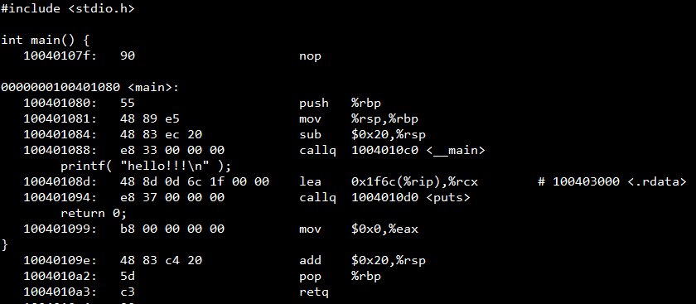
Machine code and assembly language
The hexadecimal numbers 55 48 89 e5 48 83 ec 20 e8 33 00 00 00 48 8d 0d 6c 1f etc are machine code.
The more readable mnemonics are assembly language (push %rbp; mov %rsp,%rbp; sub $0x20,%rsp …)

Slide 22
Languages
Machine code is numbers: hard for people to write and read, so we use formal languages that are easier for us to read and write, while retaining rigorous well defined mappings to machine language.
Examples:
Python, Matlab, C: look a lot like algebra
Assembly language: looks more like machine code
Python, Matlab are interpreted:
Another program (written in a language like C) reads the Python/Matlab instructions and executes them.
C, Assembly language are translated (compiled) to machine code:
Which is then executed directly by the computer.

Slide 23
Compiled languages
The program that translates C to machine code is called a compiler.
Compiled code is usually more efficient than interpreted code.
Interpreted code is translated at run time, which takes time.
Does not require the overhead of an interpreter to run.
The Python, Matlab, Java and .Net runtime environments are massive (gigabytes) in size.
So we can write programs for devices with tight resource constraints.
Small memory.
Slow clock speed.
Low power.
Often running for a long time in a hostile environment.

Slide 24
C programming
We use a text editor to write programs
Usually part of an integrated development environment (IDE)
IDE also has facilities to make us productive:
File manager
Revision control (Git)
Debugger
Terminal
Informational windows

Slide 25
Demonstration
Install CAB202 software.
Set up IDE
Look at some programs.
hello.c and f2c.c will introduce the syntax of C
menu.c is about the level of complexity that you should already be easily able to write in some structured imperative programming language.
If not, the next step is up to you.

Slide 26
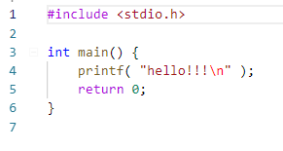
hello.c

Slide 27
hello.c
Read the contents of standard header file “stdio.h” and insert into program

Slide 28
hello.c
Begin the definition of a function called “main” which is not expecting to receive any arguments, and which promises to return an integer value.
Every C program has a function called “main”.

Slide 29
hello.c
The instructions that make up the body of main start here. This is the beginning of a block.
Every block is surrounded by paired braces.
A block is a list of statements, glued together to become a single logical instruction.

Slide 30
hello.c
The instructions that make up the body of main end here.

Slide 31
hello.c
When the program starts, this will be the first thing that happens.
It will send the text “hello!!!”, followed by a linefeed symbol, to the standard output stream.
Which might be the terminal.
printf means print formatted text.

Slide 32
hello.c
Finally, we send a “success code” back to the code that called us.
Fulfilling the promise to return an integer.

Slide 33
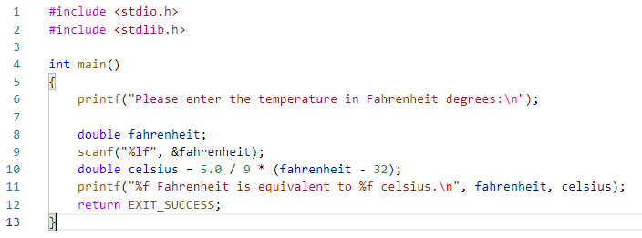
f2c_simple.c
Get a copy of “stdio.h” and insert it into our program.
Get us the declarations of printf and scanf
In C, we need to declare every variable, function, or data type, before we can use it.

Slide 34
f2c_simple.c
Get a copy of “stdlib.h” and insert it into our program.
Gets us the declaration of the symbolic constant EXIT_SUCCESS.
Which equals 0, but also conveys meaning.

Slide 35
f2c_simple.c
Ask the user to enter the temperature in Fahrenheit degrees.

Slide 36
f2c_simple.c
Declare a variable called fahrenheit, which will be able to store a floating point value.
Tells the compiler to set aside 8 bytes of memory someplace, and let us call it “fahrenheit”.

Slide 37
f2c_simple.c
The value of fahrenheit is initially undefined, because a value has not been assigned into fahrenheit yet.
We have to consider it to be garbage.

Slide 38
f2c_simple.c
Try to fetch a numeric value from the standard input stream
Which may be the keyboard.

Slide 39
f2c_simple.c
The first argument sent to scanf is a format string.
Tells scanf how to parse symbols from the input stream.
%lf means “long floating point”

Slide 40
f2c_simple.c
The next argument tells scanf the address of the place in memory where it should put the numeric result data.
& is “the address of”.
You can read this as “into fahrenheit”.

Slide 41
f2c_simple.c
We don’t know where fahrenheit is, and we don’t really care.
But scanf needs to know, so the compiler keeps track of where the variable is, and gives that address to scanf when we ask for its address.
&fahrenheit

Slide 42
f2c_simple.c
We don’t know where fahrenheit is, and we don’t really care.
But scanf needs to know, so the compiler keeps track of where the variable is, and gives that address to scanf when we ask for its address.
&fahrenheit

Slide 43
f2c_simple.c
Declare a variable called celsius, and initialise it by calculating a value.

Slide 44
f2c_simple.c
Send formatted text to standard output stream.
One format specifier for each value to be inserted into the string.
%f means “floating point”

Slide 45
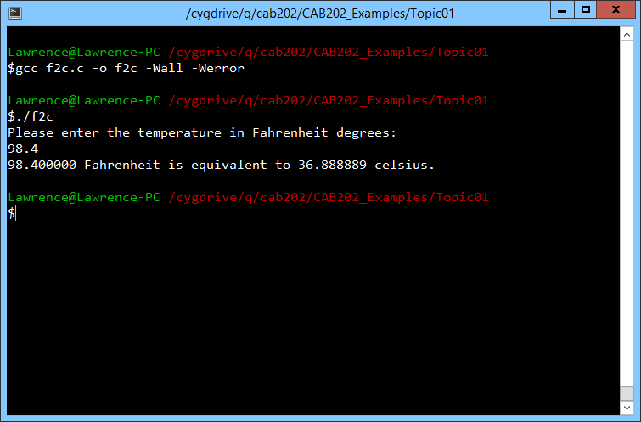
f2c_simple.c
Compile:
gcc f2c.c -o f2c -Wall -Werror
Run:
./f2c

Slide 46
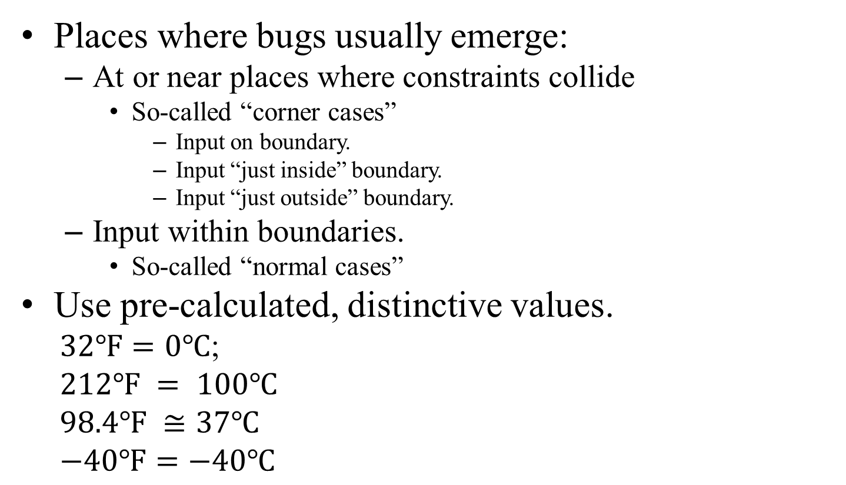
Test plan for f2c
Places where bugs usually emerge:
At or near places where constraints collide
So-called “corner cases”
Input on boundary.
Input “just inside” boundary.
Input “just outside” boundary.
Input within boundaries.
So-called “normal cases”
Use pre-calculated, distinctive values.
$32℉=0℃$;
$$212℉ = 100℃$$
$$98.4℉ ≅37℃$$
$$−40℉=−40℃$$
This program only has “normal cases”, unless you want to consider non-numeric input errors.
In a microcontroller, that is moot point, so we will by design (i.e. not by incompetence) deliberately ignore that class of “error” for now.

Slide 47
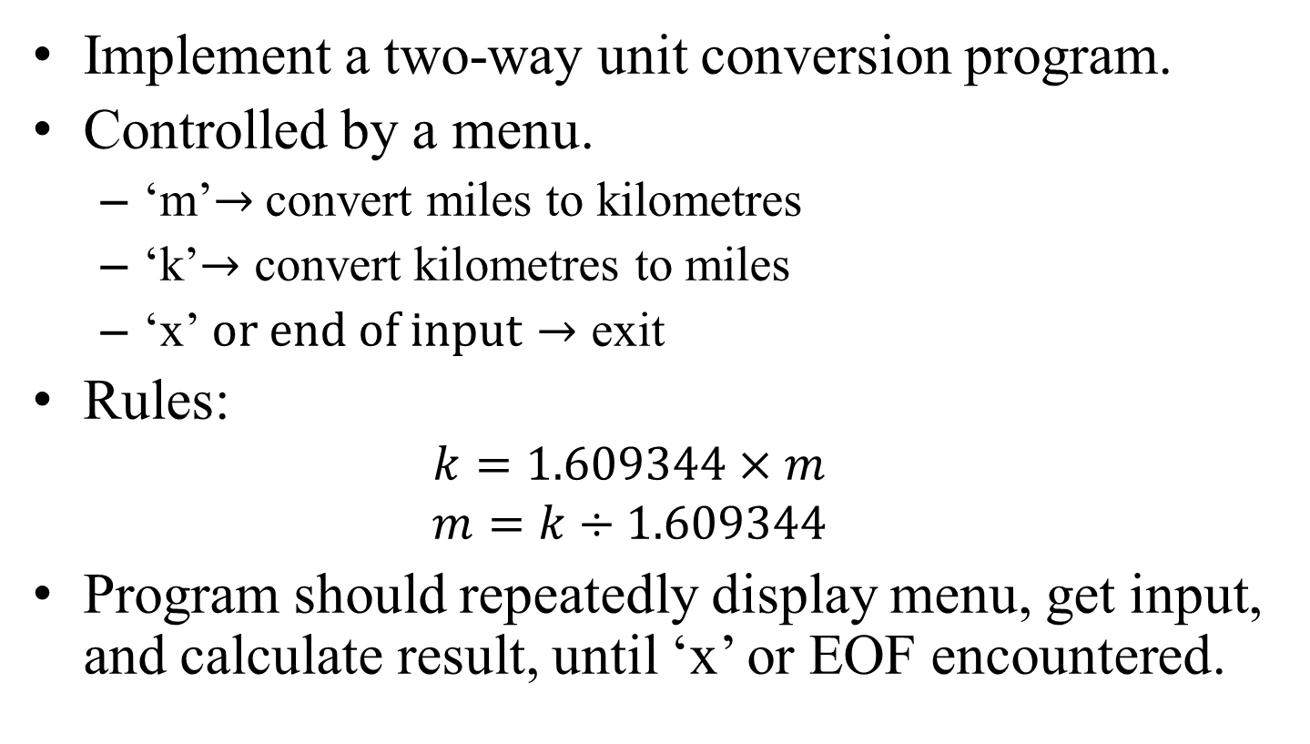
menu.c analysis
Implement a two-way unit conversion program.
Controlled by a menu.
‘m’$→$convert miles to kilometres
‘k’$→$ convert kilometres to miles
‘x’$or end of input→$ exit
Rules:
$$k=1.609344×m$$
$$m=k÷1.609344$$
Program should repeatedly display menu, get input, and calculate result, until ‘x’ or EOF encountered.

Slide 48
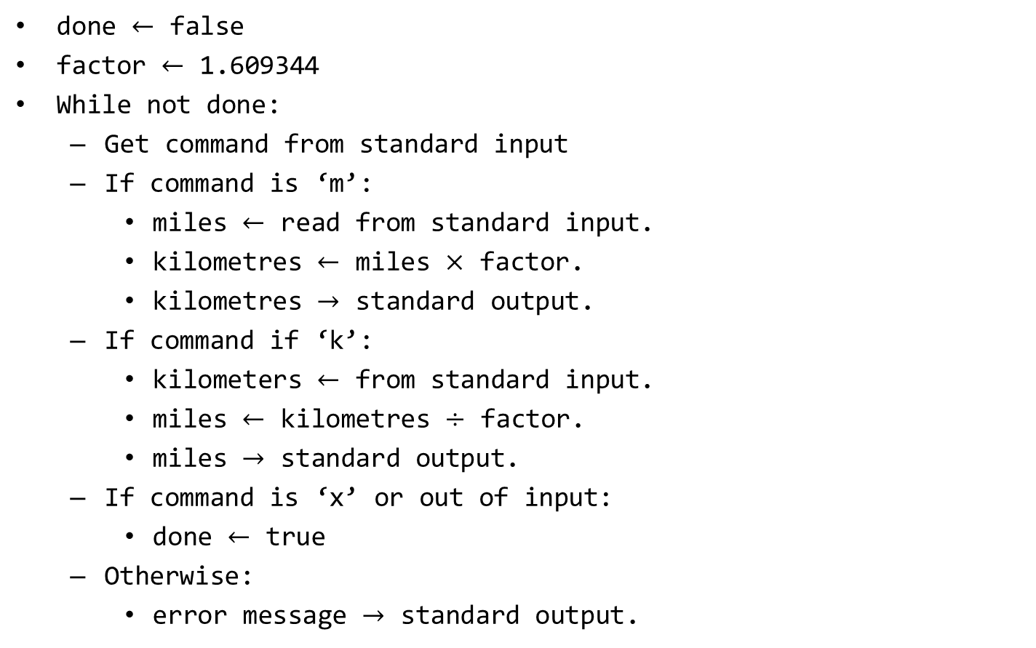
menu.c design (pseudocode)
done $←$ false
factor $←$ 1.609344
While not done:
Get command from standard input
If command is ‘m’:
miles $←$ read from standard input.
kilometres $←$ miles $×$ factor.
kilometres $→$ standard output.
If command if ‘k’:
kilometers $←$ from standard input.
miles $←$ kilometres $÷$ factor.
miles $→$ standard output.
If command is ‘x’ or out of input:
done $←$ true
Otherwise:
error message $→$ standard output.

Slide 49
menu.c Test plan (partial)
Input | Expected outcome | Observed outcome
m 10 x | Menu shown; Asks for miles; Shows “10 miles is 16.09344 km”; Menu shown; Program exit.
k 16.09344 x | Menu shown; Asks for kilometres; Shows “16.09344 km is 10 miles”; Menu shown; Program exit.
x | Menu shown; Program exit.
<empty input> | Menu shown; Program exit.
m 1 k 1 x | Menu shown; Asks for miles; Shows “1 miles is 1.609344 km”; Menu shown; Asks for kilometres; Shows “1 km is 0.621371 miles”; Menu shown; program exit.
zzz | Menu shown; Shows error message; (repeats twice more); Menu shown; program exit.

Slide 50
menu.c
One possible implementation is described in detail in the technical notes.
In the live demo, I implement a slightly simpler version.
The program demonstrates: if and while statements, the char data type, and another use of scanf.
Use this is an indicator.
If menu.c is baffling, you’re not ready for CAB202.

Slide 51
More info:
Must Read!
Topic 1 Technical Notes
Last minute updates in progress at the time of writing; will be updated on afternoon of Wed 24/07/2019 to reflect new lecture.
C reference library: http://www.cplusplus.com/reference/cstdio/
Books.
Internet.

Slide 52
End

